Slide 1
Discriminative Training of
Markov Logic Networks
Parag Singla & Pedro Domingos
University of Washington

Slide 2
Motivation
AI systems must be able to learn, reason logically and handle uncertainty.
First-order logic gives the capability to reason with sets of objects.
Probability can be used to handle uncertainty.
Markov Logic Networks (MLNs) combine logic and probability to get the best of both worlds.
Statistical Relational Learning
  Probabilistic Relational Models [ Friedman et al., 1999]
    Combination of Bayesian networks and description logics
    Directed graphical models
    Have problems with cycles
  Relational Markov Networks [ Taskar et al., 2002]
    Combination of Markov networks and conjunctive SQL queries
    Undirected graphical models
    Expressiveness confined to conjunctive queries
    Grow exponentially with clique size
  Markov Logic Networks [Richardson & Domingos, 2004]
    Combination of Markov networks and first-order logic
    Undirected graphical models
    Utilize the full power of first-order logic
    Compact description for features of the cliques
  Etc.
Why Discriminative Training?
(As Opposed to Generative)
Generative
Parameters learned are not optimized for the specific inference task.
Need to model all the dependencies in the data – learning might become complicated.
Discriminative
Parameters learned are optimized for the specific inference task.
Need not model dependencies between evidence variables – makes learning task easier.

Slide 3
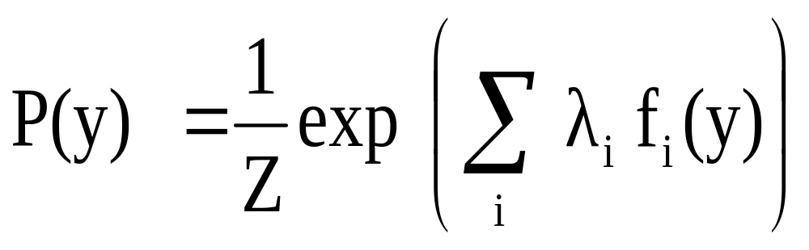
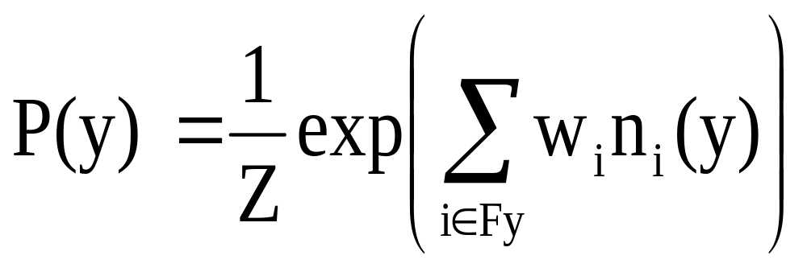

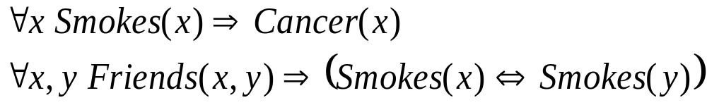
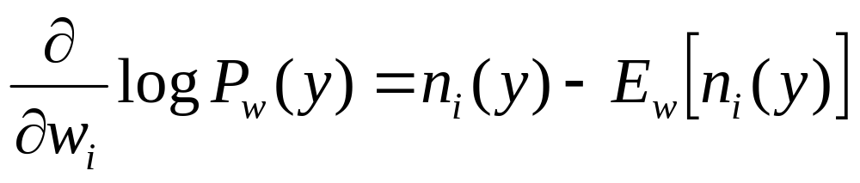
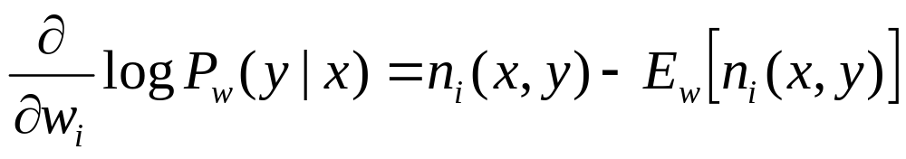
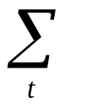
First-Order Logic
Markov Logic Networks
[Richardson & Domingos, 2004]
Markov Networks
Lets us reason about sets of objects and their relations in a formal language.
English:
All men are mortal. Socrates is a man.
Therefore, Socrates is mortal.
First-Order Logic:
(∀x Man (x) => Mortal (x))
∧ Man (Socrates)
Mortal (Socrates)
Imposes a set of hard constraints on the objects and their relations in the real world => Brittle !
∀x Smokes (x) => Cancer (x)
Not everybody who smokes has cancer!
A Markov Logic Network (MLN) is a set of pairs (F, w) where
  F is a formula in first-order logic
  w is a real number
Together with a finite set of constants,
it defines a Markov network with
  One node for each grounding of each predicate in the MLN
  One feature for each grounding of each formula F in the MLN, with the corresponding weight w
A
C
Let us make the first-order logic constraints soft.
When a world violates a formula, it becomes less probable, but not impossible.
Give each formula a weight,
  higher weight => stronger constraint
Undirected
graphical
models
B
D
Joint Distribution
Example
Weight of Feature i
Feature i
Sum over all MLN clauses with at least one
grounding containing query variables
Example of Feature f(B,C,D):
Constants = { A (Anna), B (Bob) }
Friends(A,B)
Generative Training
f(B,C,D) =
1 if B and C or D
Friends(A,A)
Smokes(A)
Smokes(B)
Friends(B,B)
0 otherwise
Cancer(A)
Friends(B,A)
Cancer(B)
Expected # of true groundings; requires complete inference – slow!
# true groundings of
formula in DB
MaxWalkSAT
[Kautz et. al, 1997]
Discriminative Training
Voted Perceptron
[ Collins 2002]
MaxSAT
  Given: A boolean formula in clausal form
  Find: Assignment maximizing the sum of weights of satisfied clauses
MaxWalkSAT
  Stochastic local solver for MaxSAT
  Mixes greedy search with random walks
Algorithm:
Gradient of Conditional Log Likelihood
Generalized Voted Perceptron
Finding MAP state of a ground Markov network
  State maximizing the sum of weights of satisfied ground clauses
  Can be reduced to equivalent MaxSAT problem
  Use MaxWalkSAT
Replace Viterbi by MaxWalkSAT in Voted Perceptron algorithm:
Used for discriminative training of linear-chain Markov networks (e.g., hidden Markov models)
Expected count in the gradient approximated by MAP count
MAP (most likely) state found using Viterbi algorithm (dynamic programming)
Algorithm:
  start with some configuration of variables
  for i = 1 to max-flips do
  - randomly pick an unsatisfied clause
  - with probability p, flip the literal giving
  most gain
  - with probability 1-p, flip a random literal
    in the clause
  - update the best assignment obtained
  end for
  repeat max-restarts times
# true groundings of
formula in DB
Expected # of true
groundings – slow!
  initialize w_{i}=0
for t=1 to T do
find the MAP configuration using MaxWalkSAT
Δw_{i,} = η * (training count – MAP count)
end for
  initialize w_{i}=0
for t=1 to T do
find the MAP configuration using Viterbi
Δw_{i,} = η * (training count – MAP count)
end for
Approximate expected count by MAP count
w_{i} = w_{i,t}/T (avoids overfitting)
w_{i} = w_{i,t}/T (avoids overfitting)
Dealing with First-order logic
  Propositionalize the knowledge base before passing it to MaxWalkSAT engine

Slide 4
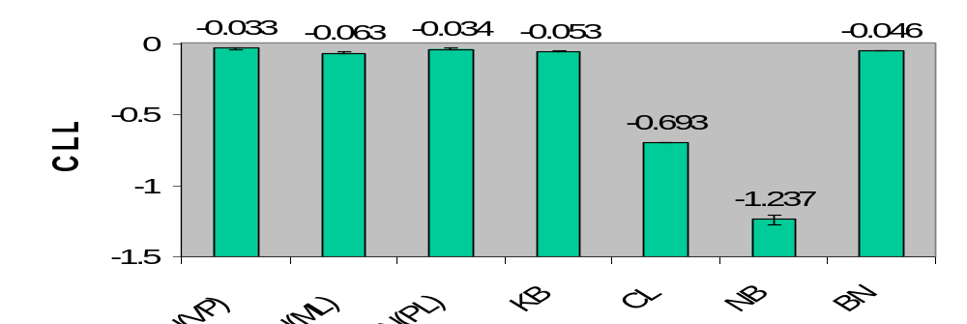
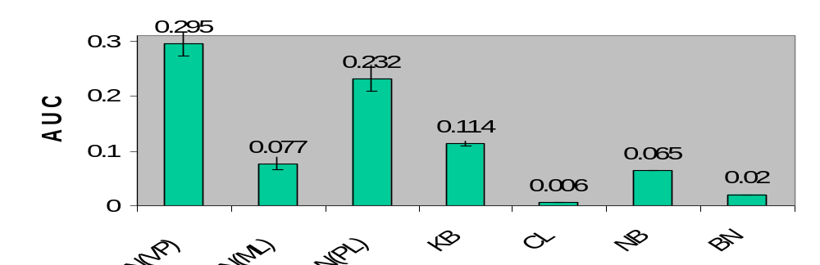
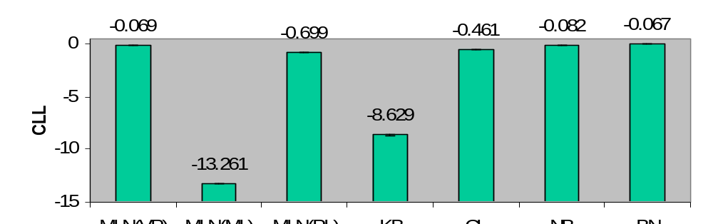
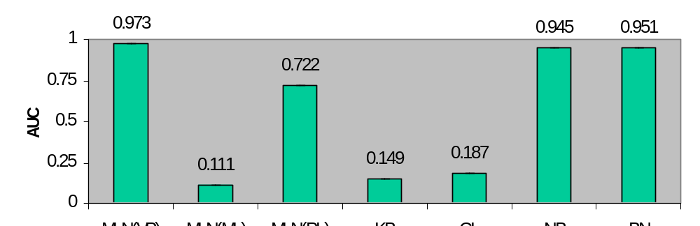
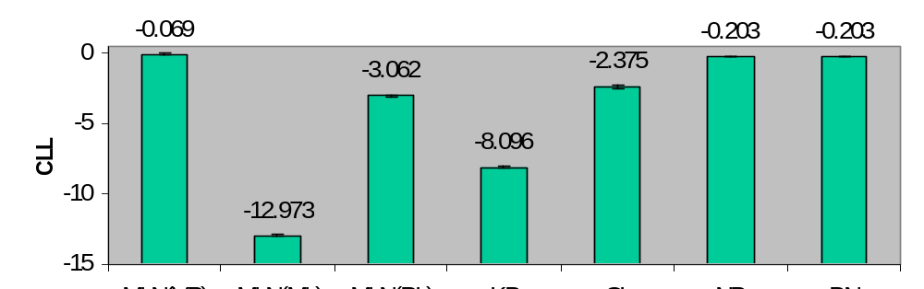
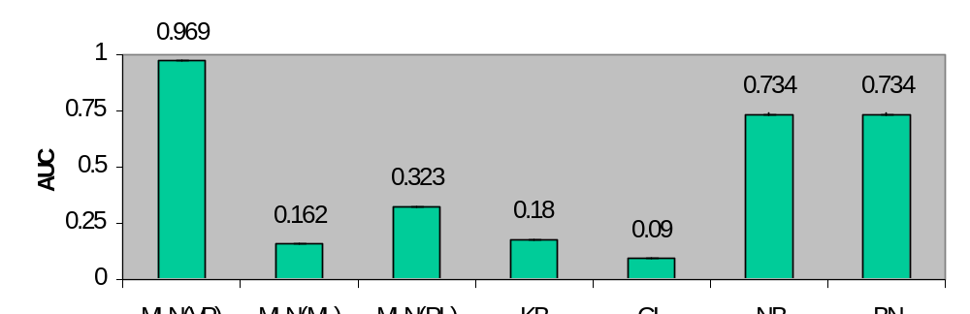
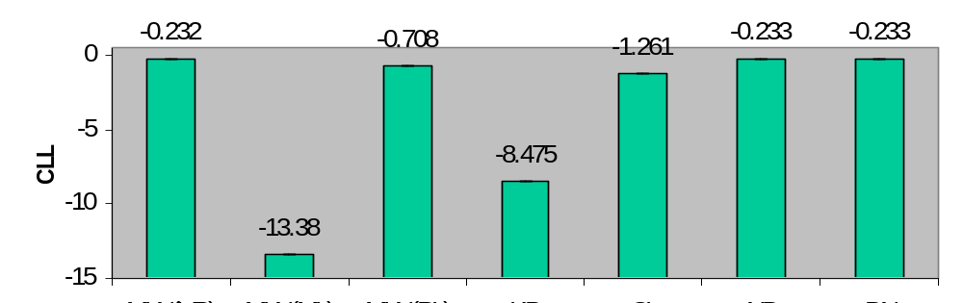
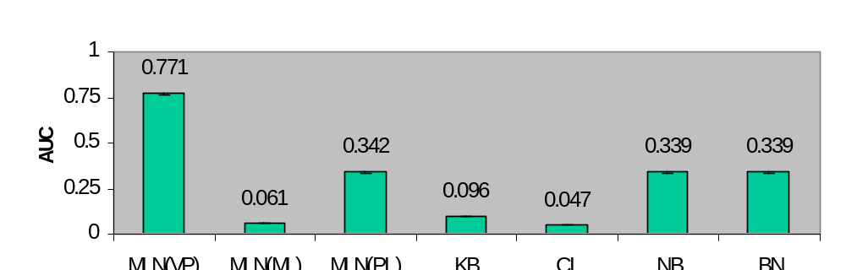
Experiments
Domains
UW-CSE database
  Database of people/courses/publications at UW-CSE
  22 Predicates e.g. Student(P), Professor(P), AdvisedBy(P1,P2)
  94 hand coded rules stating various regularities
    Student(P) => !Professor(P)
  Predict AdvisedBy predicate
Cora
  Cleaned up version of McCallum’s Cora database.
  1295 citations to 132 difference Computer Science research papers, each citation described by author, venue, title fields.
  46 hand coded rules stating various regularities
    Author(b1,a1) ∧ Author(b2,a2) ∧ SameAuthor(a1,a2) => SameBib(b1,b2)
  Predict SameBib, SameAuthor, SameVenue
Link Prediction on UW - CSE
Matching Citations on Cora
Conclusions
Markov Logic Networks: A powerful way of combining logic and probability
Developed an algorithm for discriminative training of MLNs
  Combines Voted Perceptron with a weighted satisfiability solver
Discriminative training using Voted Perceptron better than
  Generative training
  Purely probabilisitc approaches
  Purely logical approaches
Matching Authors on Cora
Future Work
Discriminative learning of MLN structure
Maximum-margin learning of MLN parameters
Extensions of MaxWalkSAT
Further application of MLNs to entity resolution, de-duplication and other tasks
Matching Venues on Cora
Legend
CLL: Conditional Log-Likelihood
AUC: Area Under Precision-Recall
Curve
VP: Voted Perceptron
ML: Maximum Likelihood
PL: Pseudo-Likelihood
KB: Knowledge Base
CL: Claudien
NB: Naive Bayes
BN: Bayesian Networks

